Slide 1


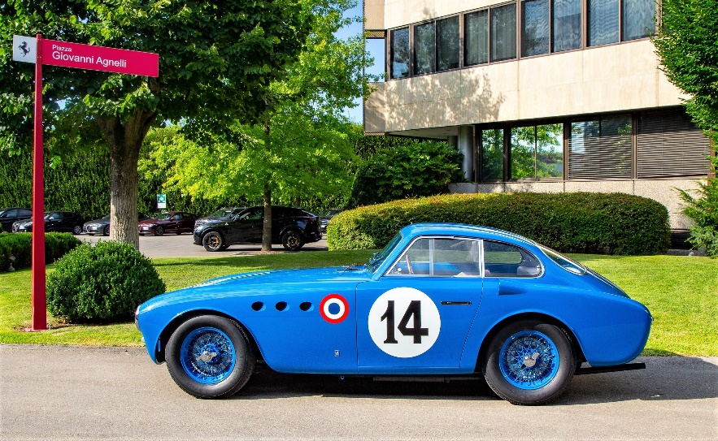
Ferrari Club of America
Concours
Coppa Bella Macchina
Coppa GT
Futuro Classico
October 26, 2019
Concours info: FCA web site – Events – FCA Concours events, Concours documents

Slide 2
Authentic Ferrari Names
“Modena” -- 360 Modena
“Lusso” -- 250 GTL Lusso Berlinetta
“Fiorano” – 599 GTB Fiorano
“348 TB Challenge” -- 348 Challenge
“Fiorano 599” -- 599 GTB Fiorano
“16M” -- 430 Scuderia Spider 16M
“Italia” -- 458 Italia
“Maranello” – 550 Maranello or 575M Maranello?
308 GTS – 308 GTSi – 308 GTS QV – they are distinct
F355 – 355 F1
Use of the guide in the back of Cavallino as standard nomenclature

Slide 3
The Competition Sequence
Driver demonstrate competency, & proficiency
Platino
Pass/Fail
Coppa Bella Macchina
Coppa GT Award
Concours
Coppa GT
Originality &
Condition
Driver skills
100% functional
Up to three of the best drivers

Slide 4
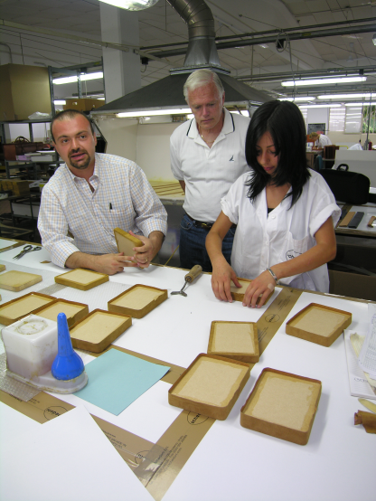
Concours Awards
Class Awards:
- Cars divided into roughly similar classes (varies with number
of entries)
- Cars in each class evaluated against standards (not against
others in the class
97 + points = Coppa di Platino (may be multiple awards)
    92 + = Coppa d’Oro (one)
    87 + = Coppa di Argento (one)
Major awards: (chief class judges)
  All Platino winners are considered
  All considered equal

Slide 5
Concours Judging Guidelines
The FCA uses: International Advisory Council for the Preservation of the Ferrari Automobile (IAC / PFA):
  Establishes the Judging Guidelines and judging forms and awards.
  Independent of FCA – independent council of 20 members
Three person teams for each class (Interior, Exterior, Engine/Chassis)
Must be driven onto field – fully assembled
Owner, or designated representative, presents the car during judging
  Inform the judges of unusual features & provide documentation
  Preservation cars must have history of preservation/maintenance (documentation)
  Race cars must be as originally manufactured OR as raced (need documentation)
  Classiche Certification – engine and drive train are authentic (Red Book)
  New(er) cars – what was original; what factory options (documentation)
At start of judging, each car is assumed to have 100 points. Deductions of 0 to 5 points
are taken on each judged component
Judges will ask that you demonstrate windows, engine, instruments, doors, lights, etc.

Slide 6
Concours Judging Guidelines (cont.)
Top up or removable panel in place. Electrically operated tops must be demonstrated
Engine will be run and checked for leaks, smooth idle, instruments, etc.
Factory options are considered original, after-market options are not.
Factory-provided pollution equipment must be in place w/ working appearance
Replacement items must be similar in size, characteristics, and appearance as original
(replacement items are: tires, battery, all windows, spark plugs, filters, hoses, etc.)
All originally provided tools, manuals, pouches, etc. (good reproductions ok)
Safety items such as seat belts, fire extinguisher, side mirror, and alarm are ok but must be unobtrusive and neatly installed
Conversions and unauthorized rebodies are ineligible for judging

Slide 7
Maximum Deductions
Exterior |  | Interior |  | Engine/Chassis
Coachwork, body | 5 | Headliner | 2 | Engine type | 5
Doors, hood, trunk | 4 | Upholstery (seats, console, doors) | 4 | Engine serial number | 1
Top | 3 | Carpets, pedal, shifter | 2 | Engine, auxiliaries, transmission, differential | 4
Paint | 5 | Dashboard & instruments condition | 3 | Fluid lines (oil, fuel, water) | 3
Plating | 3 | Steering wheel, levers, controls, column | 2 | Electrical system components, incl. battery | 3
Lights condition | 4 | Trim & emblems | 2 | Fuel system, carbs, injection, linkages | 2
Trim / Emblems | 3 | Window operation | 2 | Wheels & tires | 4
Glass, plexiglass | 3 | Trunk (carpet, paint, decals, hardware) | 2 | Underside, fenders & frame | 2
Rubber, window felt | 3 | Tools, spare, and manuals | 4 | Chassis, brakes, suspension components | 3
 |  | Instrument operation (clock, radio, A/C, lights) | 5 | Exhaust, mufflers, pipes, cats, manifolds, hangers | 2
 |  | Exterior light operation | 5 | Engine operation, smoothness and leaks | 5
TOTAL EXTERIOR | 33 | TOTAL INTERIOR | 33 | TOTAL ENGINE/CHASSIS | 34

Slide 8
Race Cars in Concours
Race cars are judged by this criteria:
Older race cars:
  As it left the factory, or
  A particular race in period
Newer race cars:
  As it left the factory, or
  The series/event, sanctioning body and dates. You provide the documentation describing the configuration requirements
    Examples: Ferrari Challenge Series; 550 GTS (Prodrive); 360 N-GT (FIA, ALMS, LeMans); F430 GT (FIA, ALMS, Le Mans); 458 Italia GT & GTC (ALMS, LMS, Le Mans)
  Must be authentic purpose-built Ferrari race cars with documentation provided by owners

Slide 9

Documenting New(er) Ferraris
Every car is a custom one-off -- what is original?
Options that came on this car (599 GTB Fiorano). Data from Ferrari dealer.
      “Personalization” options that are
      factory authorized (458 Italia)
Obtain the information for your car!

Slide 10
Checking the Interior
Minimal or no deduction for minor wear areas
Everything must work: clock, instrument lights, interior lights, backup light, radio, A/C, fans, vents, etc.
Seats / door panels / carpet must be of similar material as original (leather, vinyl,
cloth) and assembled as original (seat pleating, piping, door map pockets)
Headliner - original style and color
Original steering wheel type – no after market
Windows operate smoothly
Tools, manual, and spare must be as originally provided with the car
Trunk – correct carpet, interior light, paint, overflow hoses, etc.
Trim correct – screws (slotted vs. Phillips), bevels, washers, finish, etc.
Door gaskets / window seals correct and in good condition
Seat belts are ok – even if not originally fitted – if unobtrusive & neatly installed

Slide 11
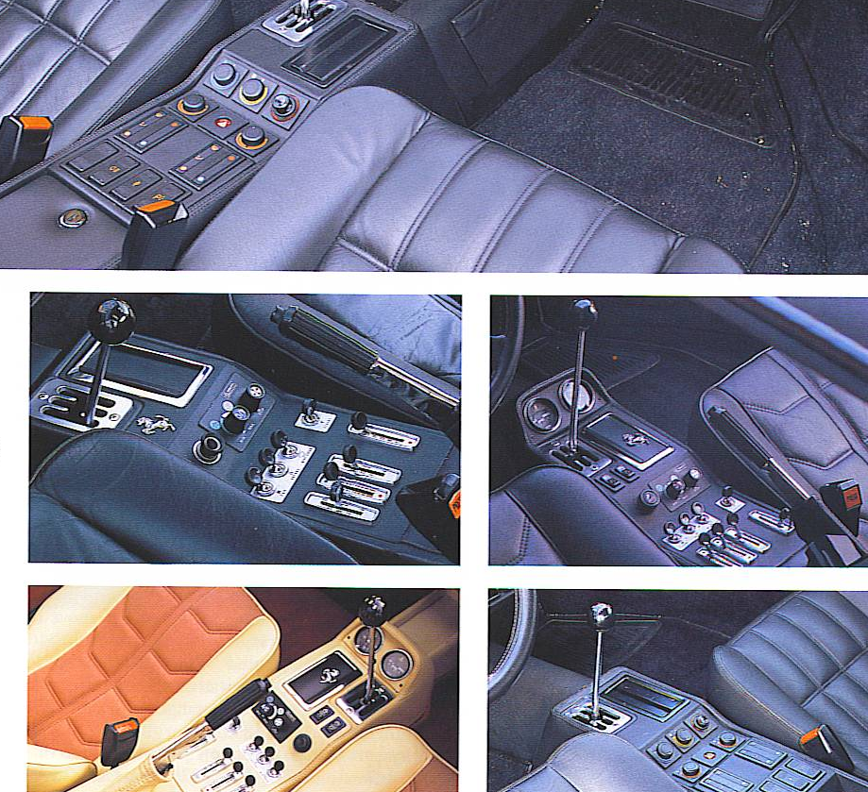
Checking the Interior

Slide 12
Checking the Engine Compartment / Chassis
No leaks of fuel, oil or water; hoses correct
Plating on clamps, pipes, nuts correct
Compartment / chassis paint correct
Decals in place – DoT, EPA, firing order, paint, etc.
Correct paint for radiator, air cleaner, cam covers
Smooth idle, no exhaust leaks
Underneath: Correct profile tires, wheels, brakes, hoses, paint,
undercoat
Plating of metal components correct
Correct engine type and serial number
Insulators for spark plugs, condensers, modules, etc.
Correct exhaust – not aftermarket
Battery – neat and unobtrusive replacement, same size as original

Slide 13
Checking the Exterior
Badges: correct for car; no aftermarket badges
Glass: correct size and fit – does not need original logo
Color: must be an appropriate period color for Ferrari when
manufactured
Lenses: correct tail lights, turn signals, headlights.
All exterior lights must work properly
Paint / chrome: good but does not have to be spotless; minor paint
chips ok as evidence of use.
Top: same style, material, and assembly as original
Outside rear view mirror, radio, etc. “neat, unobtrusive, . . .”
Panel fit: gaps correct (as originally manufactured)
Bumper: proper gaps, mounts

Slide 14
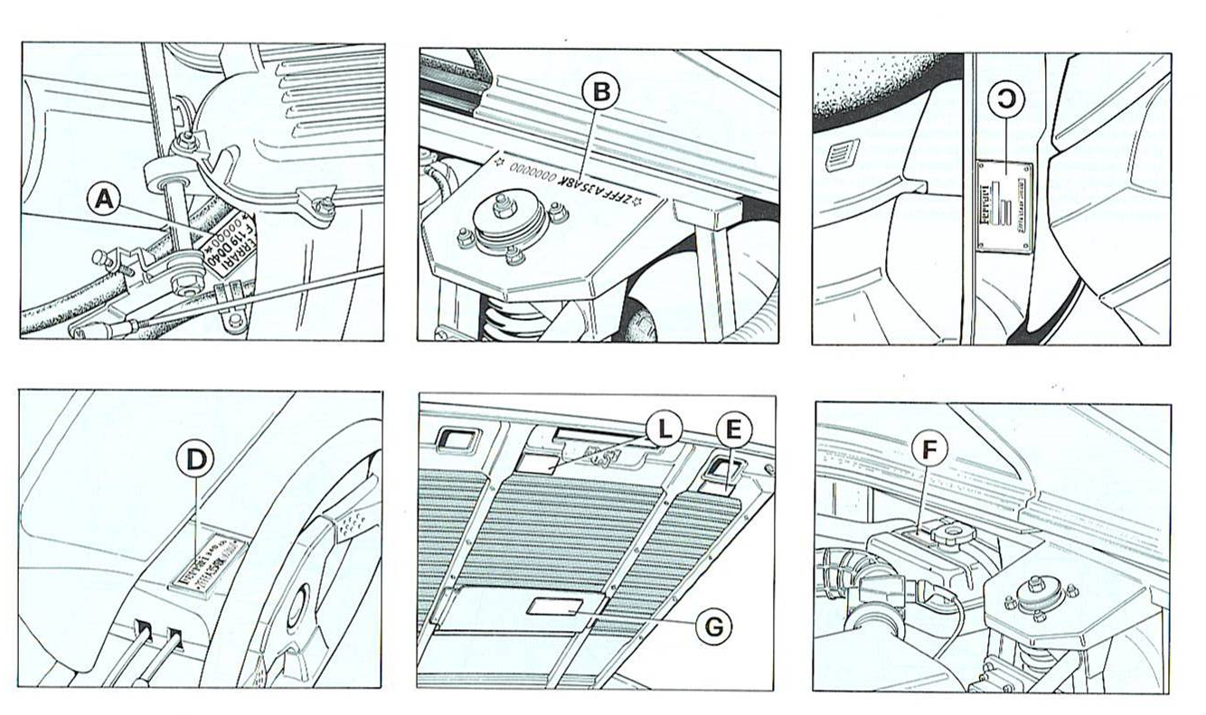
Labels

Slide 15
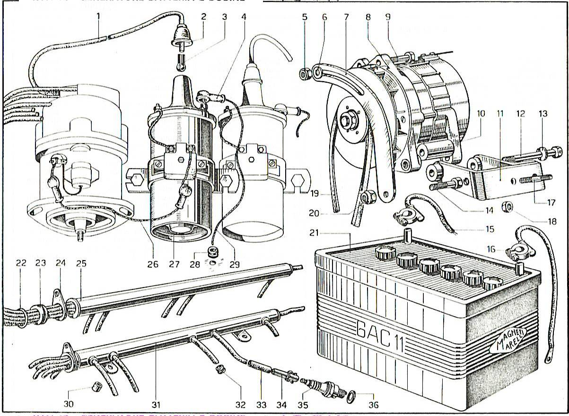
Checking Electrical

Slide 16
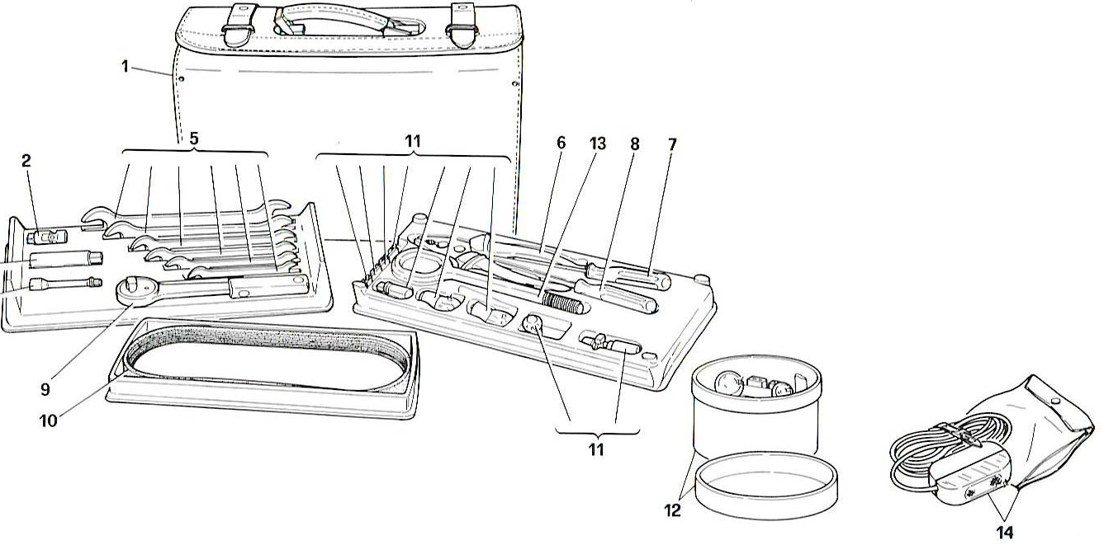
Checking Tools

Slide 17
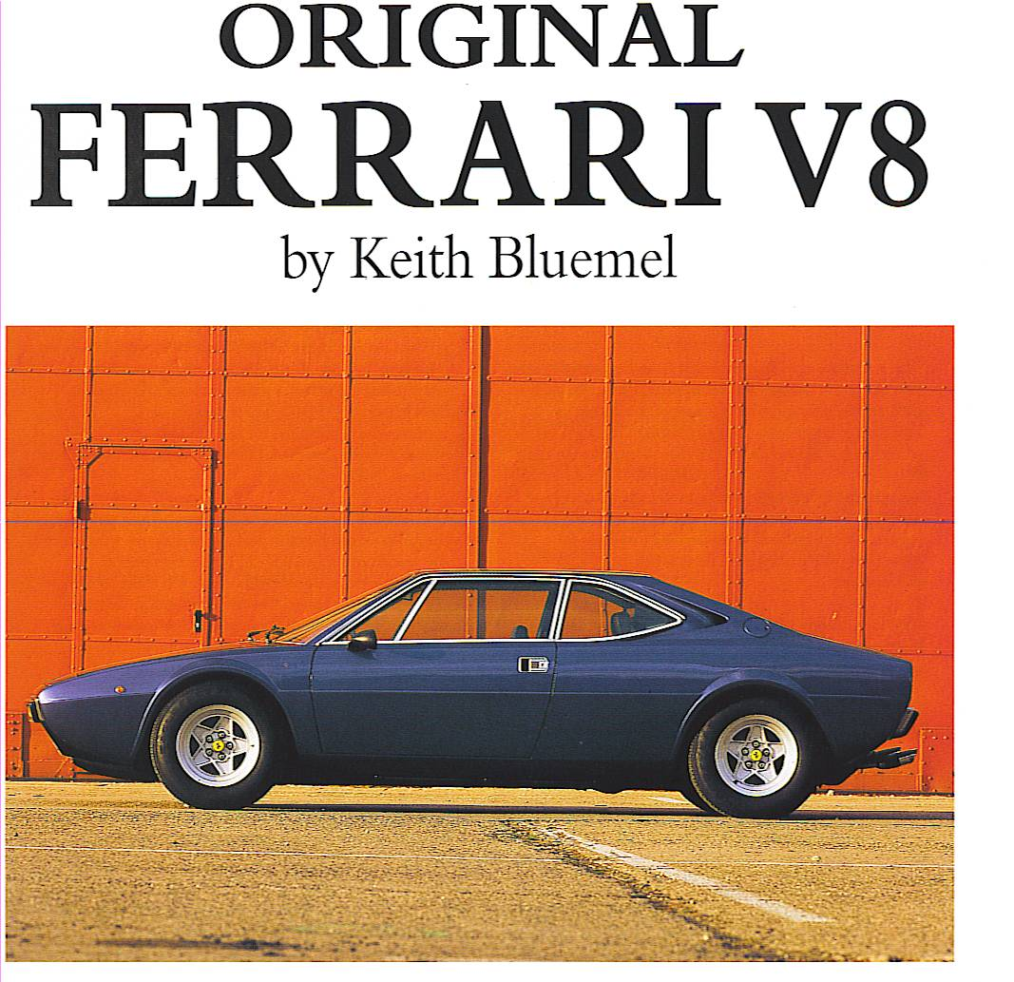
Do Your Own Research --
Talk to People -- Look at Their Cars

Slide 18
Typical Deductions for Early Cars
Poor (or too perfect) fit of doors, hood, trunk lid, rubber
Oil or gas leaks
Incorrect hose clamps
Poor idling of engine
Incorrect hardware – nuts, bolts, brackets, etc.
Poor condition – rust, corrosion, dirty
Incorrect / damaged headliner materials
Poor interior / seat condition or restoration
Heel pad missing / incorrect
Missing portions of tools and manuals
Poor fit of bumpers
Incorrect painting underneath
Non-original exhaust
Stained / dirty carpets
Miscellaneous suspension components w/ incorrect paint or plating
Research what is correct before putting your hands on it!

Slide 19
Typical Deductions for Later Cars
Removable and convertible tops dirty or torn
Aftermarket parts – door jams, console, exhaust, wheel center caps
Non OE fender badges
External light lenses dirty and cracked
Aftermarket exhaust, air boxes, etc.
Engine compartment corrosion
Various electrical bulbs do not work
Poor condition of decals
Extra carbon fiber trim
Aftermarket carpet / mats
Rear bumper alignment
Significant dash warpage
Rubber gaskets cracked / deteriorating
Non OE calipers
Drilled/slotted rotors
Aftermarket valve stems / caps
Aftermarket hose clamps (Home Depot?)
Sticky interior parts
Most are condition based.
More emphasis on
originality. Document factory
as-delivered & accessories.
Buy documented cars - keep
documentation.
Normal wear is acceptable –
negligence is not
See Preservation next

Slide 20
Preservation Class
Originality is the primary criteria without regard for condition as long as the part can serve its intended purpose.
The Standard: Does the item, part, fabric, plating, or coating appear to be that which was specifically installed or applied on this car at the time of manufacture?
Goal:
  Retain factory originality and reward the best examples that have not been restored in any way except to maintain them to be functional.
  Reference tool for the benefit of all Ferrari owners.
Criteria:
  30 years or older.
  3 person judging teams.
  97 or more points earn Preservation Platino; no Oro or Argento awards.
  Age credit for older cars.
  Caveat: Care must be taken when attempting to correct deficiencies to not further detract from originality.
  .
Summary: Encourage owners not to restore their cars beyond what is necessary to maintain functionality.
  Owners who drive their original cars can compete.

Slide 22
The Competition Sequence
Up to three of the best drivers
Coppa Bella Macchina
Coppa GT Award
Concours
Coppa GT
FOCUS
Car:
Originality
Authenticity
Condition
Car:
- Completely functional
Driver:
- Demonstrates competency, proficiency, and knowledge
Car and Driver recognition

Slide 23
Coppa Bella Macchina
Objective: recognition that every component and accessory works precisely as delivered.
Prerequisites: Must have 97 points or better in Concours (Platino) and have entered the CBM (also: owner shows car & present driver’s license, insurance, registration)
Procedure: Detailed operational evaluation checklist. Pass or Fail. Static & road test
In case of a problem: One hour to fix one problem
Preparation: Check your own car before the evaluation (checklist / owners manual)
Historical failures:
  Windshield wipers & washers don’t work (no fluid, incorrectly aimed)
  Missing / inoperable trouble light; interior light does not work
  A/C or radio or tape player does not work (no demo tape or CD)
  Glove box does not lock – no key; door won’t stay up on its own
  Engine misfire; turn signals don’t self cancel
  Clock or other instrument (or instrument light) does not work
  Seat belt warning lights and buzzers don’t work
  Door locks don’t function correctly
  One or more engine warning lights illuminated – air bag light?
  Race cars: no documentation of authorized race modifications.
  Headrests don’t go up/down
  Engine / trunk lid won’t stay up unassisted.

Slide 24
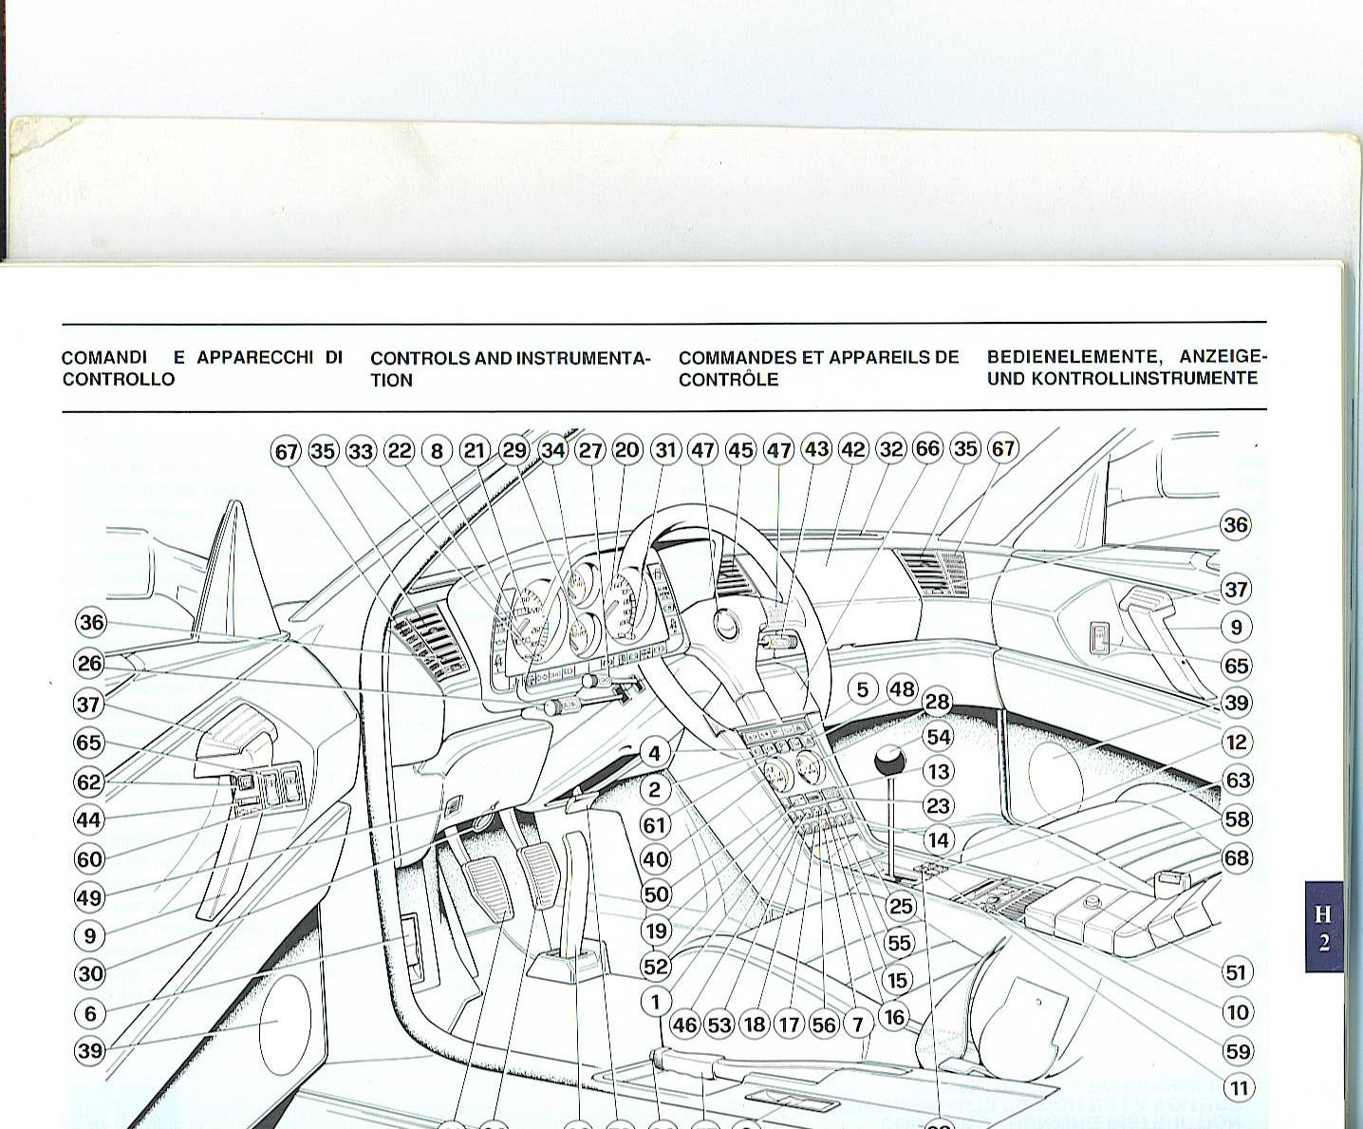
Controls and Instrumentation
Use to supplement the CBM Check sheet

Slide 25
The Competition Sequence
Up to three of the best drivers
Coppa Bella Macchina
Coppa GT Award
Concours
Coppa GT
FOCUS
Car:
Originality
Authenticity
Condition
Car:
- Completely functional
Driver:
- Demonstrates competency, proficiency, and knowledge
Car and Driver recognition

Slide 26

Coppa GT
Highest award an individual can receive in the FCA
Evaluation of driver skills on the track at a speed consistent with the car’s capabilities by non-partisan track evaluators familiar with FCA objectives
  Safety equipment
  Attitude, preparedness, knowledge, awareness
  Skills when approaching the limit
  Dealing with the unexpected
  Comply with all local track / safety rules
  Comfortable with handling car at speed vs
  “tunnel vision”
Suggestions
  Drive your car on the street – get comfortable with car
  Get track instruction and experience – preferably at CGT track
Historical problems
  General lack of familiarity with car (acceleration, braking, placement on track)
  Not smoothly shifting or twitchy handling of car – erratic brakes / throttle
  Failure to obey flags
  Unfamiliar with track and/or unfamiliar with car’s capabilities at speed
  Loss of mental awareness – come in too early or late; passing zones
  Over-reliance on electronic handling
  Uncomfortable with other cars – passing / being passed.
  Effective use of the car’s power band

Slide 27

Futuro Classico
Encourage owners to keep Ferraris in their
original state with all the accessories
Document the as-delivered condition
Train judges for future use
Establish database

Slide 28
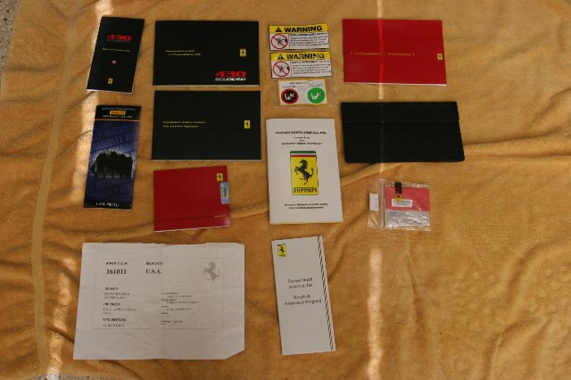
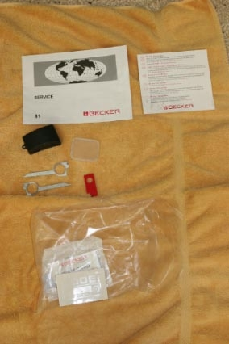
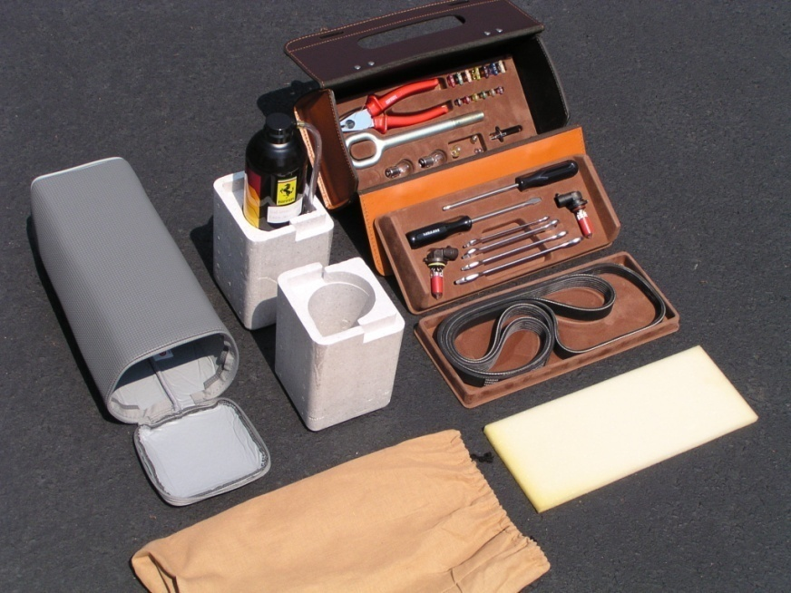
Futuro Classico
All components, options, and
accessories from factory
100% pass / fail
Certificate of authenticity for
those cars found eligible.

Slide 29
Additional topics

Slide 30
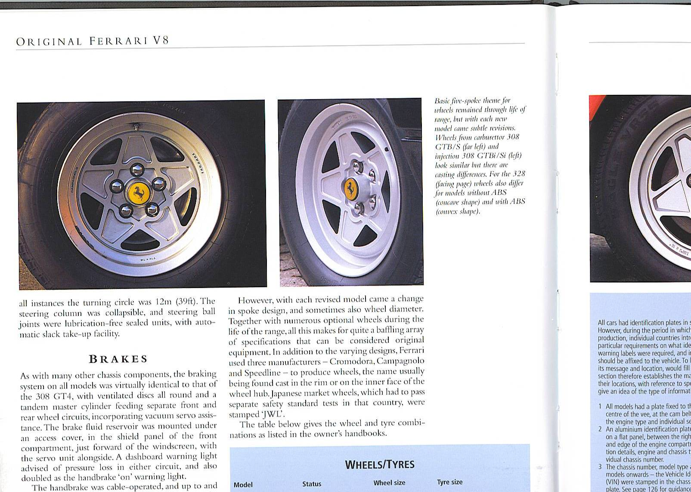
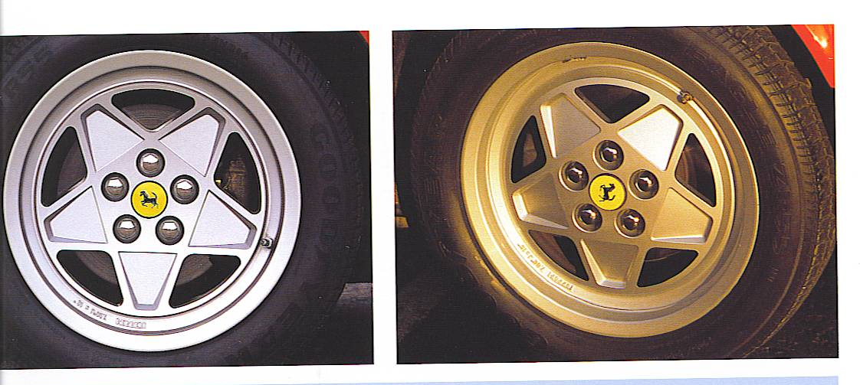
308 / 328 Wheels
Left: 308GTB/S Carburetor
Right: 308GTBi
Left: 328 w/o ABS
Right: 328 w/ ABS

Slide 31
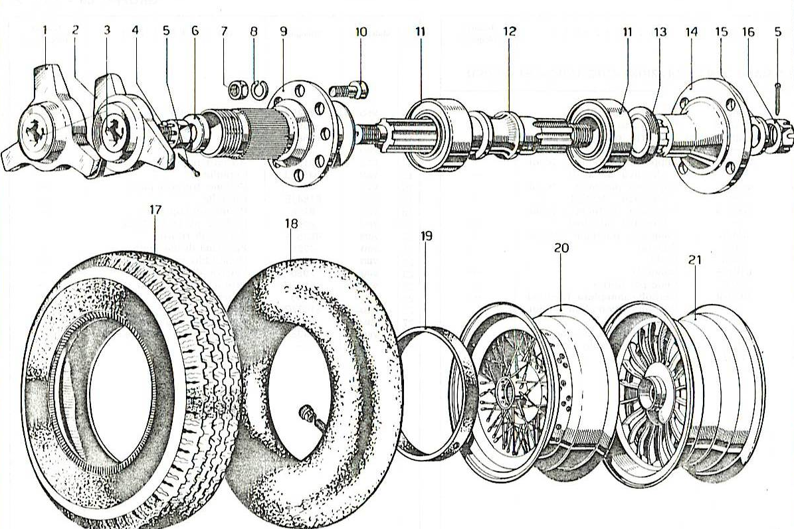
Wheels

Slide 32
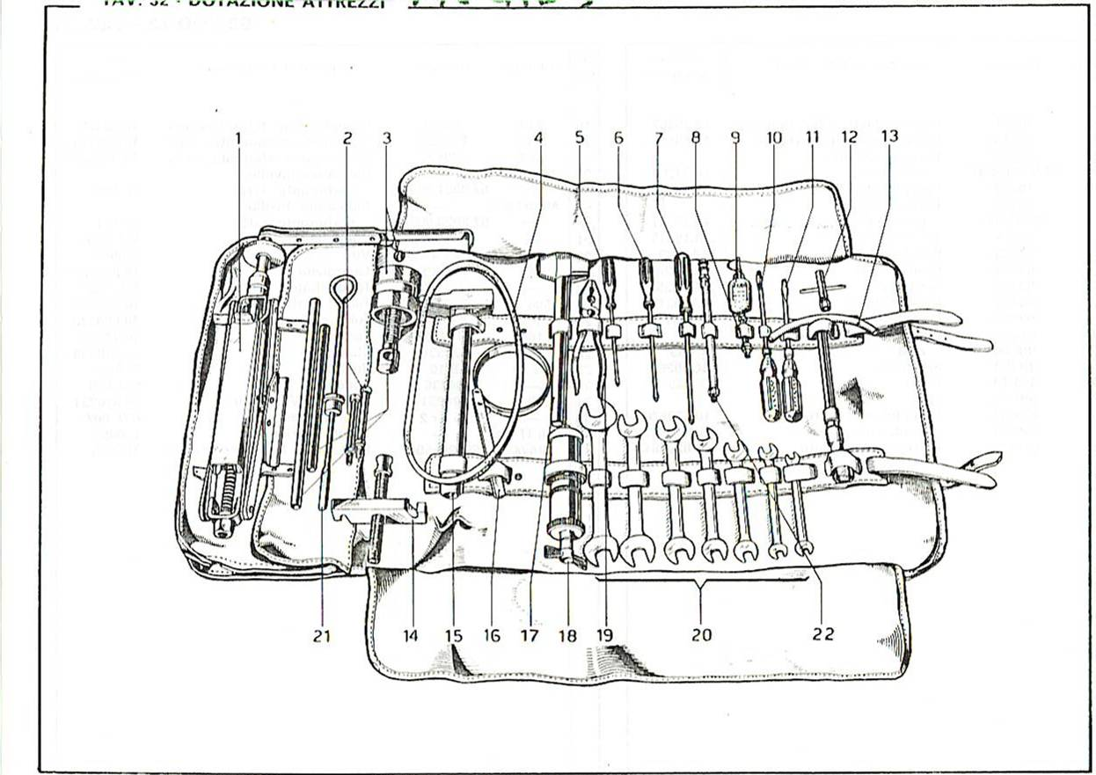
Checking Tools

Slide 33
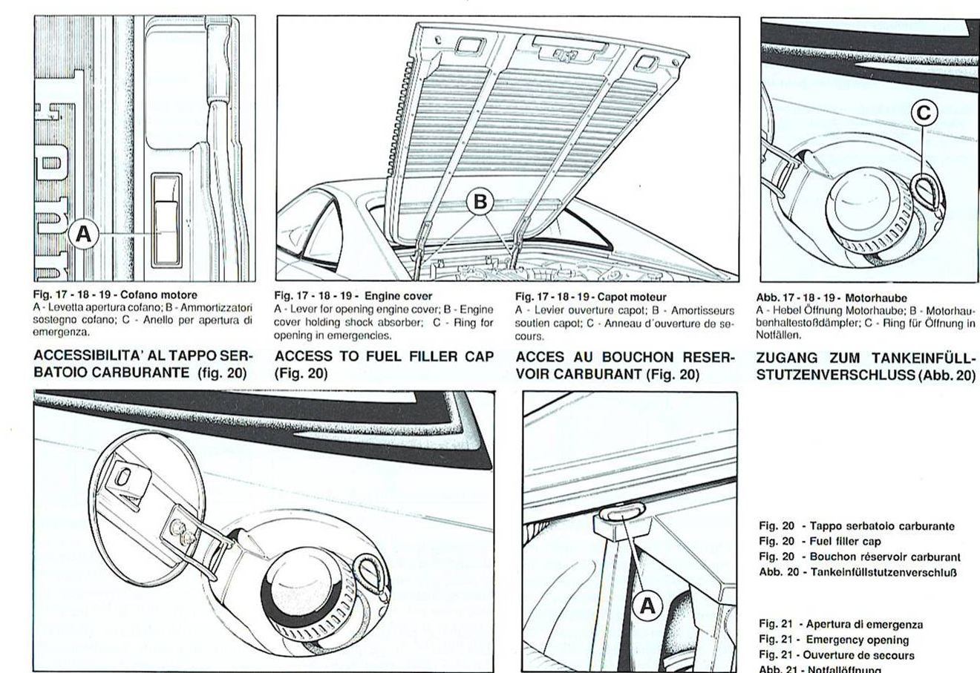
Various Checks

Slide 34
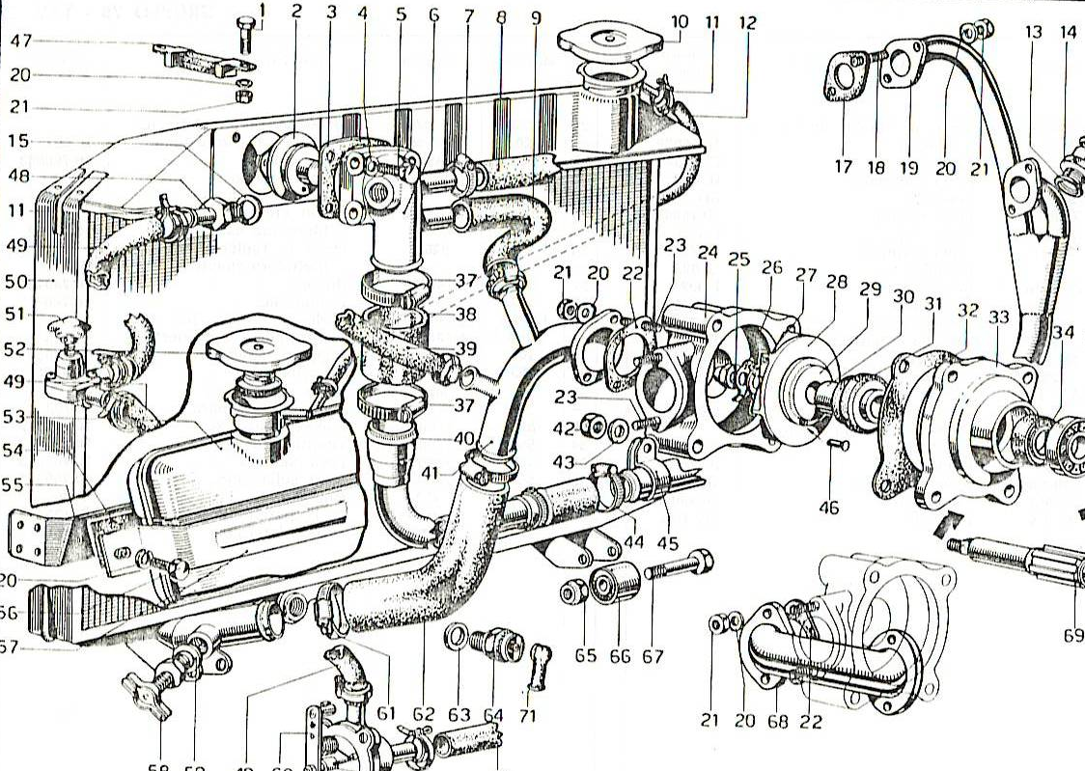
Checking Engine Cooling

Slide 35
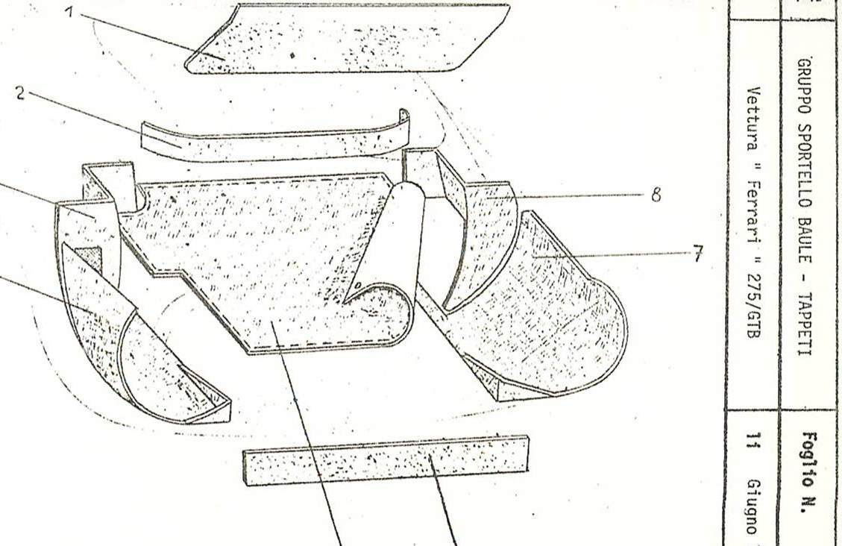
Carpets

