Slide 1

Ferrari Club of America:
Using RegFox for Events

Slide 2

The Benefits of RegFox
Let RegFox do the work and collect your funds from your event attendees and deposit funds directly into your Region or Chapter bank account
Streamlined reports for attendee rosters, tickets sold, and bank deposits
Unlimited users with the ability to set user restrictions on what each user can see and access
Multiple events can be live at one time
FCA Staff can access your RegFox to assist with troubleshooting
Unlimited library of prior events and the ability to copy prior event page templates
A waitlist can be created for limited capacity events
Refunds can be processed within RegFox
Allows you to create professional event web pages that can be easily shared with members

Slide 3
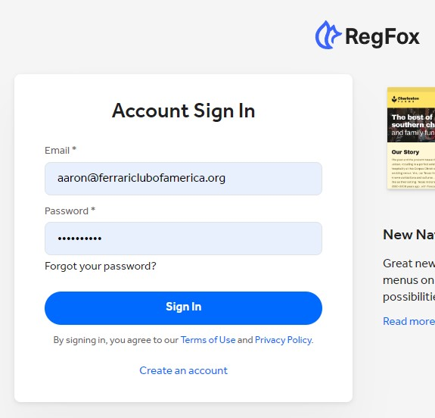
Logging In
Where: RegFox Login
Username= your email
Password will be created by you once you receive the email invite to Join RegFox by FCA Staff
The Invite email will have “Ferrari Club of America” in the subject line and be sent from “noreply@webconnex.com” so please check your spam folder if you do not see it in your inbox

Slide 4
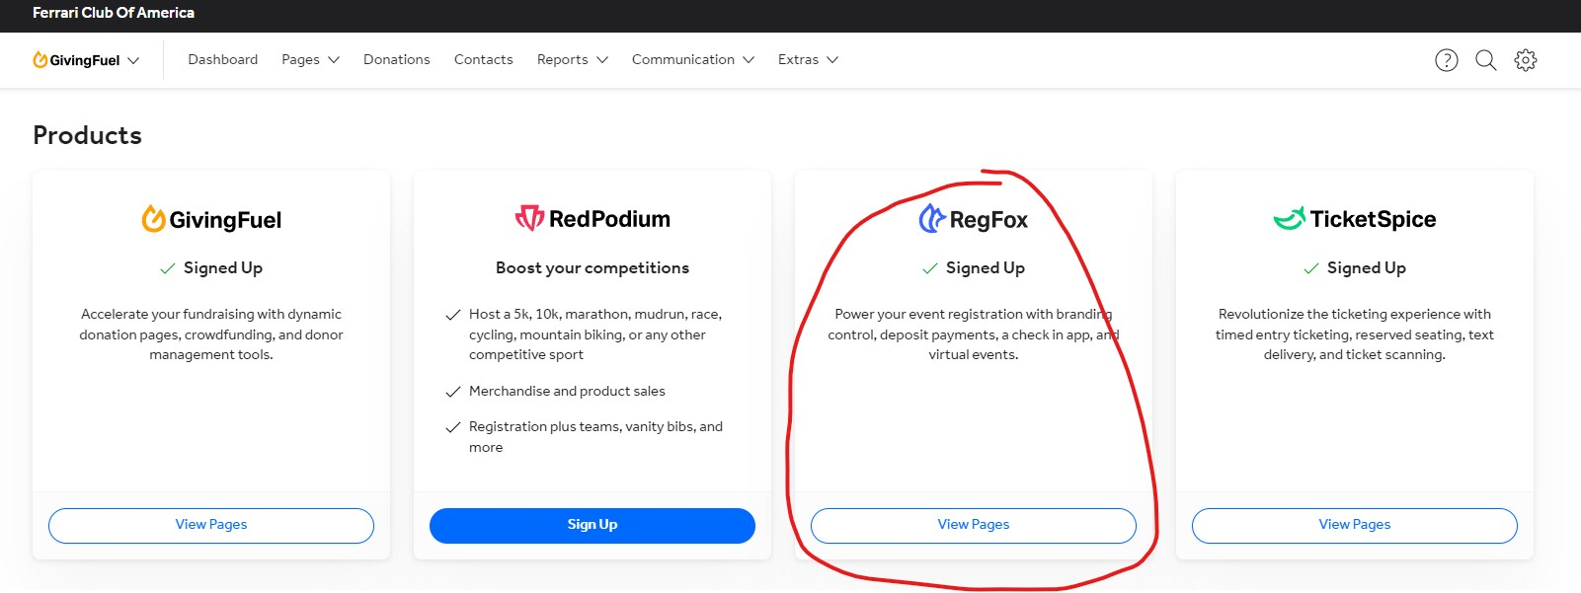
After Logging In
Click “View Pages” under the RegFox heading

Slide 5
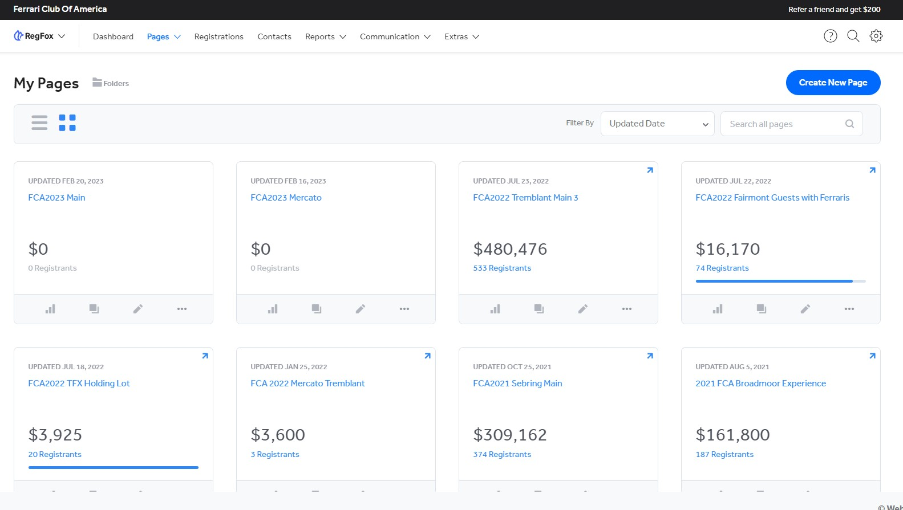
Event Pages Dashboard
The Event Pages Dashboard will show all events created and give you a snapshot of funds collected for each.
From this page you can view, edit, and pull reports for each event

Slide 6
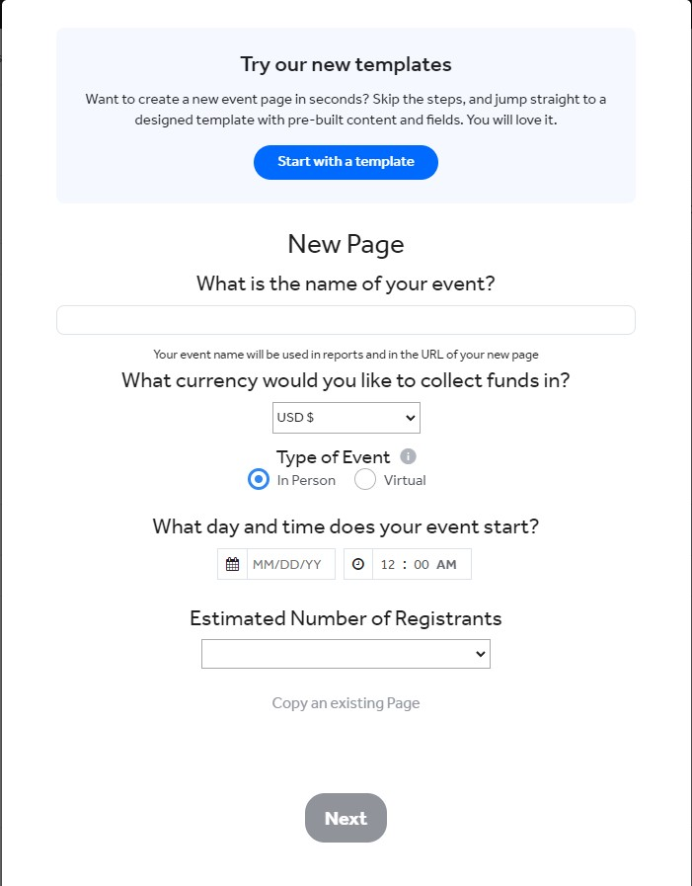
Creating an Event
Click “Create New Page” in the top right of the Event Pages Dashboard
RegFox will prompt you to fill in the necessary event information
RegFox has pre-built templates you can use when creating events
Please reach out to Aaron Pierpoint at FCA National if you need assistance in creating your first event. aaron@ferrariclubofamerica.org
Helpful user guides and videos can be found here: https://help.regfox.com/en/articles/5552514-regfox-checklist

Slide 7
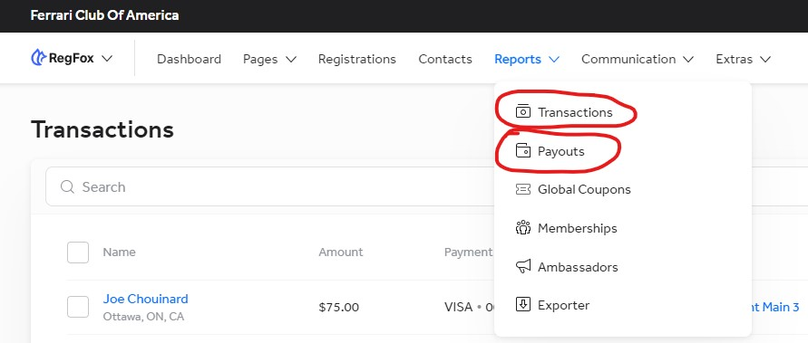
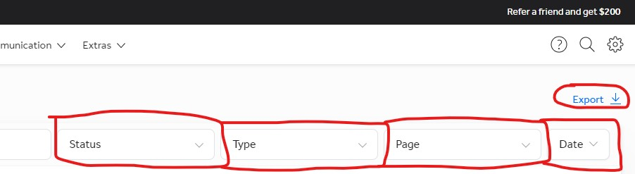
Admin Options: Reports
To access reports for event registrations or bank deposits, click reports in the top menu. For a list of registrations click “transactions”. For a list of bank deposits click “payouts”
Registrations Report can be filtered by: Status, Type, Page, or Date.
If you filter by “Page” you can view registrations for certain events only.
Reports can be exported to excel by clicking “export” in the top right

Slide 8
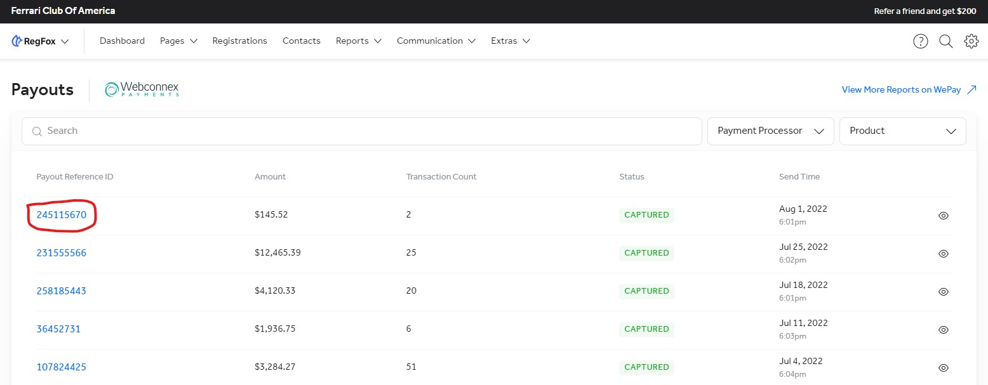
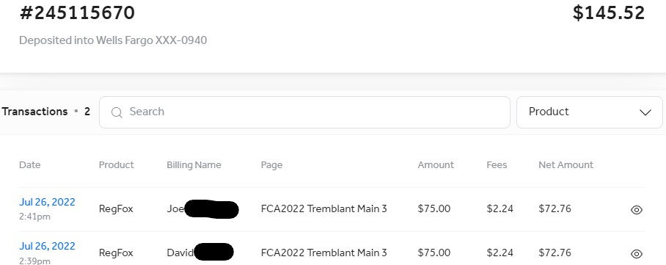
Admin Options: Reports Cont'd
Clicking Reports-Payouts allows the Treasurer to match RegFox deposits with deposits into your Region/Chapter bank account
After clicking the blue “Payout Reference ID” above, the Treasurer can see what transactions made up that deposit and can separate income by event. As shown here.

Slide 9
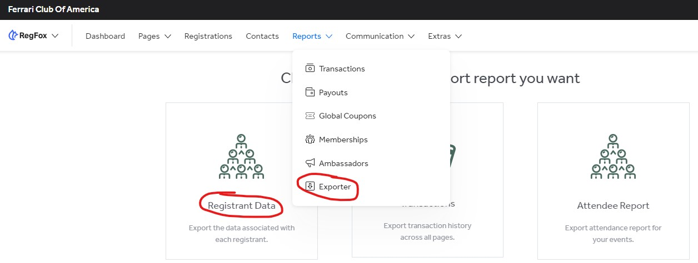
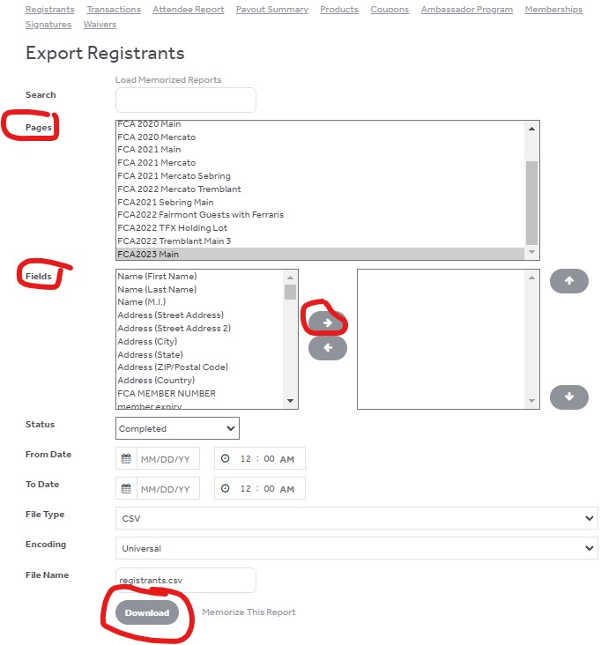
Admin Options: Reports Cont'd
Clicking Reports-Exporter-Registrant Data allows you to pull a report showing all the selections a member made when purchasing a ticket (meal choice, model, which ticket purchased, etc)
Choose the event and select all the fields you want to export and then click download. This will provide an excel report of all the selections made by the ticket purchaser for that particular event

