Slide 1

Ferrari Club of America:
Managing Groups
As a Chapter President or Regional Director, you'll want to communicate with your group members through your groups in the Online Community.

Slide 2

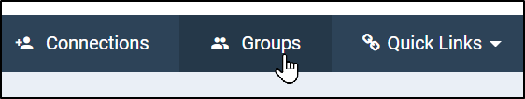
Accessing Groups
You can access your groups by clicking on "Groups" when viewing your profile.

Slide 3
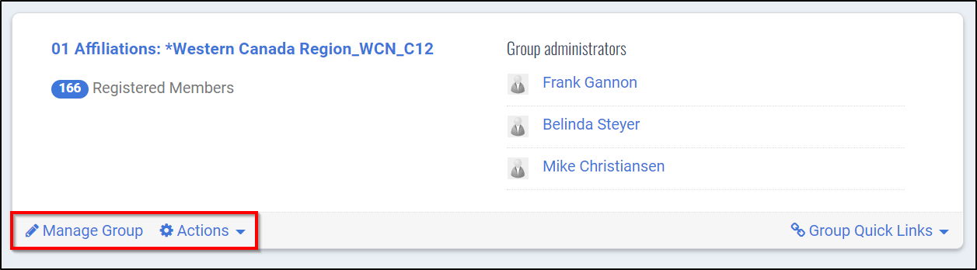
Admin Status
When you're on the main Groups page, you'll see any groups that you're in.
Any group that you're an admin of will give you the option to "Manage Group" in the bottom left (if you don't see this option, please contact an FCA Staff member)

Slide 4
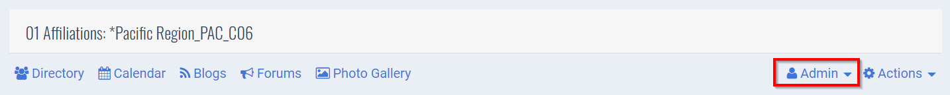
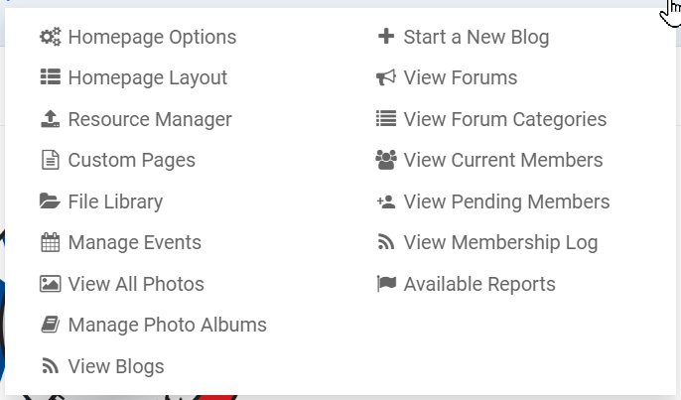
Admin Options
After you click on the name of the group, you'll see the group homepage as well as the Admin menu
If you click the Admin option you'll get a
menu of things you can do as an admin

Slide 5
Admin Options: Emailing
To email your group, please use the Constant Contact account for your Chapter or Region
  You can login to your Constant Contact account here: https://login.constantcontact.com/login/
If you haven't been given credentials to login to Constant Contact, please reach out to FCA Staff

Slide 6
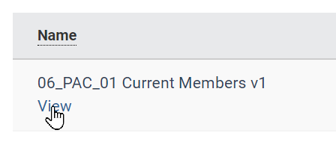
Admin Options: Reports
To find reports for your group, click Admin, and then click "Available Reports"
Once there, hover over a report and click "View"

Slide 7
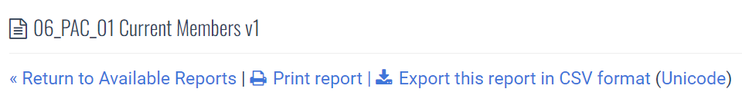
Admin Options: Reports Cont'd
On the report page you'll see the members listed for that report as well as some options on what you want to do with the report
Clicking "Print Report" above will bring up the page in printable form
Clicking "Export this report in CSV format" will allow you to download the report into an Excel file

