Slide 1

Ferrari Club of America:
Database and Constant Contact How-To
As a Chapter President or Regional Director, you'll be able to manage your Group in the database and use Constant Contact to keep in touch with your membership.

Slide 2

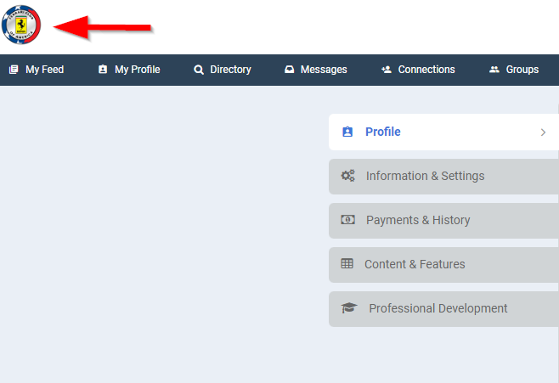
Getting to the Homepage
If you are signed into your account and would like to get to the front-end, click the Ferrari Club logo in the top left of the screen.

Slide 3
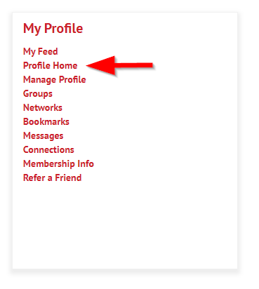
Getting back to your Profile
To get to your profile from the homepage, scroll down and choose “Profile Home” under “My Profile”.

Slide 4
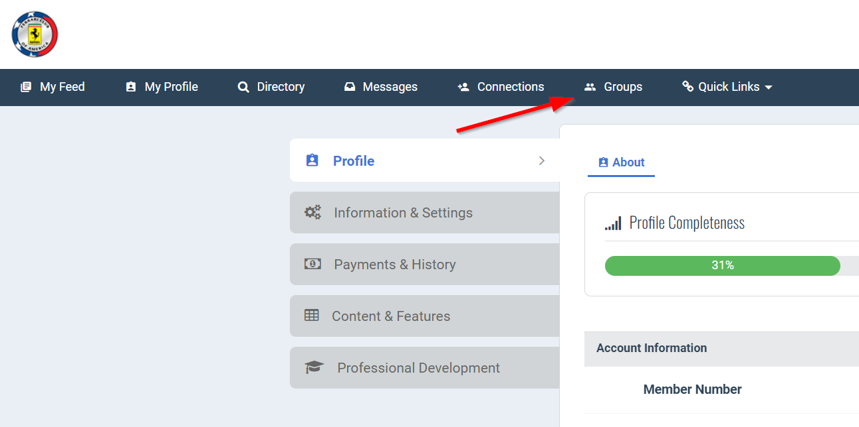
Getting to Region/Chapter from Profile
To get to your Region or chapter

Slide 5
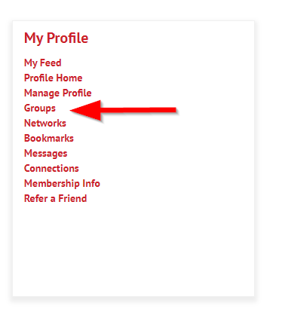
Getting to your Region/Chapter from your homepage
To get to groups from the homepage, scroll down and choose “Groups” under “My Profile”.

Slide 6
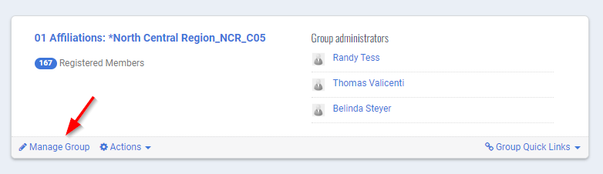
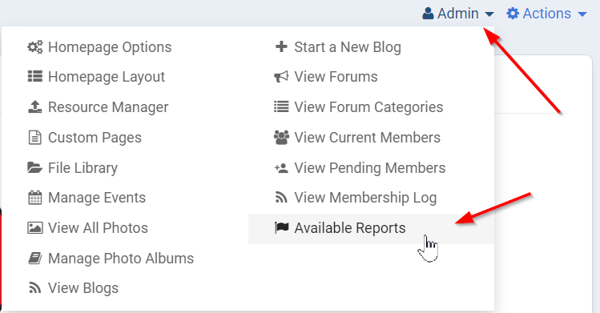
Getting to your Reports.
On the Groups page, you’ll want to locate your group and click “Manage Group
Click “Admin” on the top right and then click “Available Reports” in the bottom right of the pop-up.

Slide 7
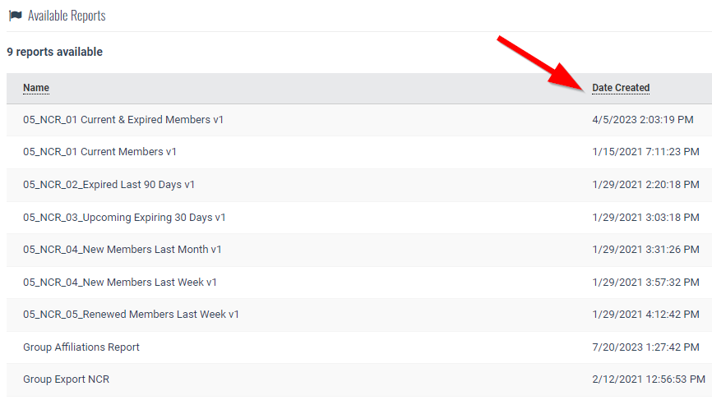
Reading reports
The date you see under the "Date Created" column is the date the report was made. The data within the report is dynamic, meaning it updates with membership changes regularly.

Slide 8
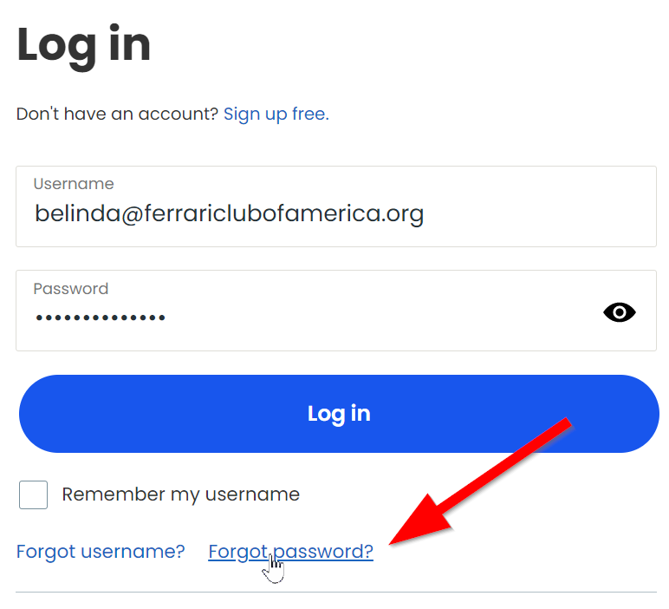
Logging in to Constant Contact
Where: https://login.constantcontact.com/login/
An invitation or Username will be sent to you as RD or CP
Password: If you were not sent the password previously, you can reset your password by choosing the "Forgot Password" option and having a reset email sent to you.

Slide 9
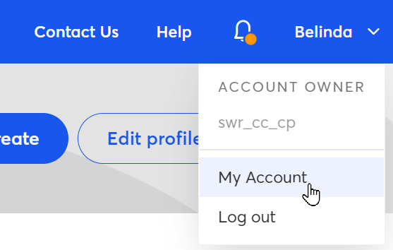
Update Account
The very first thing that needs to be done when you login for the first time is to verify your account information and update anything that is incorrect or missing.
To get to your account click on your name in the top right corner and then click on My Account

Slide 10
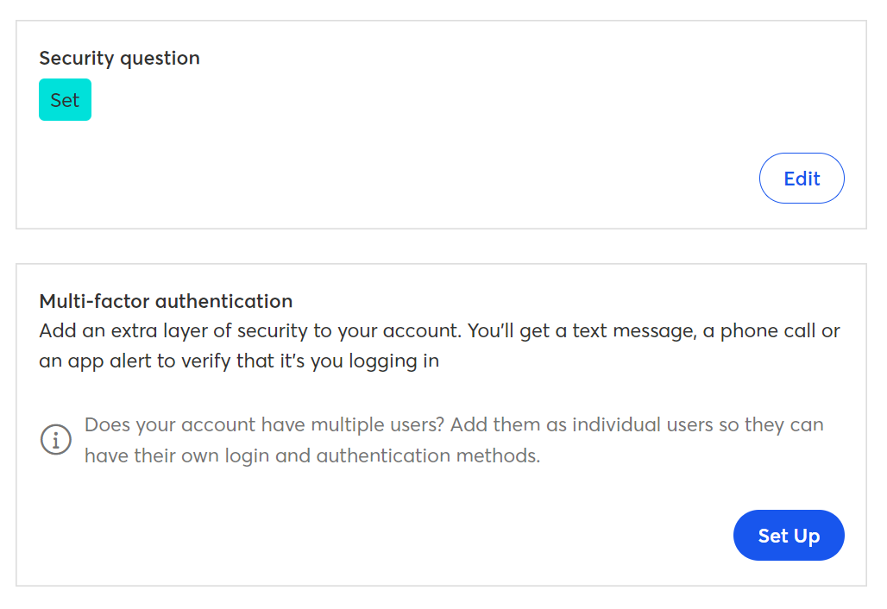
Required
The information that is required to be updated are the Security Question and the Multi-Factor Authentication.

Slide 11
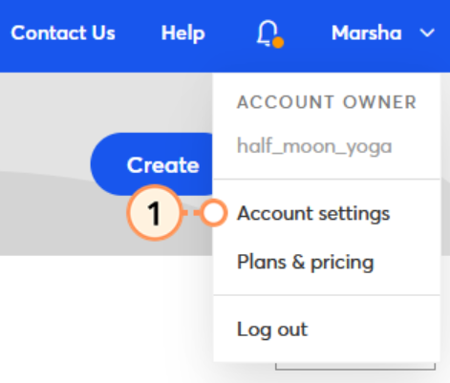
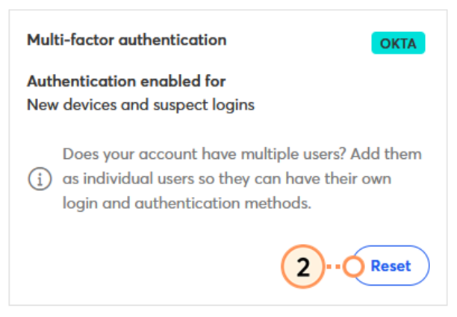
Adding MFA
Click the profile name in the upper right corner and select “Account Settings”
Scroll down to find the MFA tile.

Slide 12
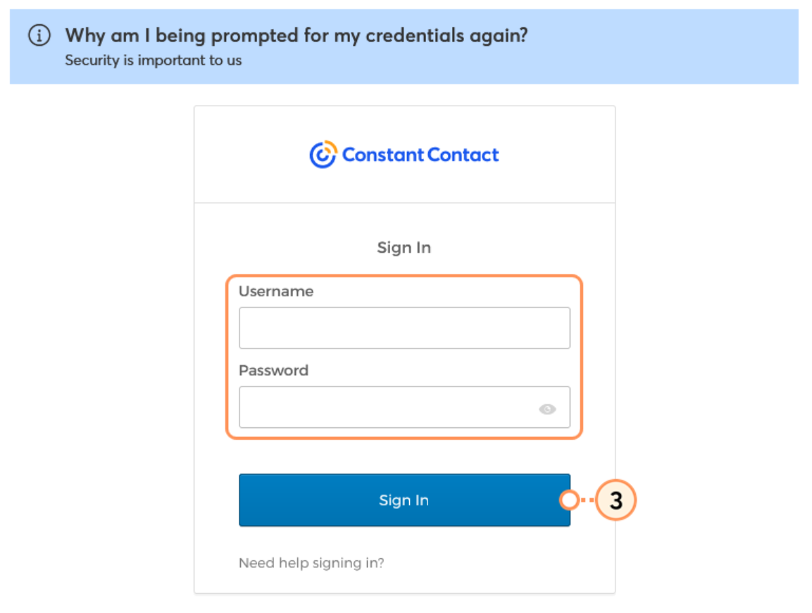
Adding MFA
You will be prompted to input your credentials again for safety.

Slide 13
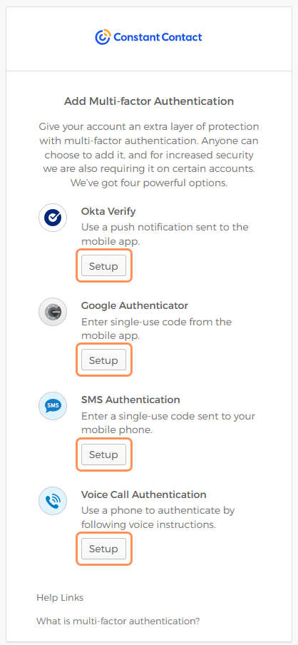
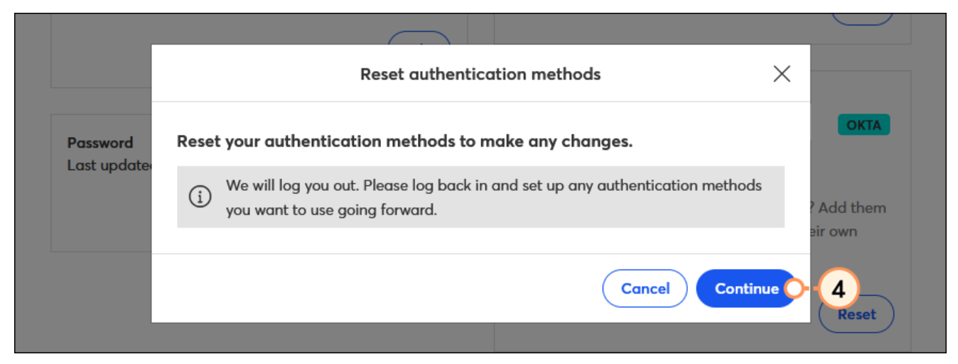
Adding MFA
After you click continue, you’ll be prompted to login again (below)

Slide 14
Adding MFA
After you click continue, you’ll be prompted to login again

Slide 15
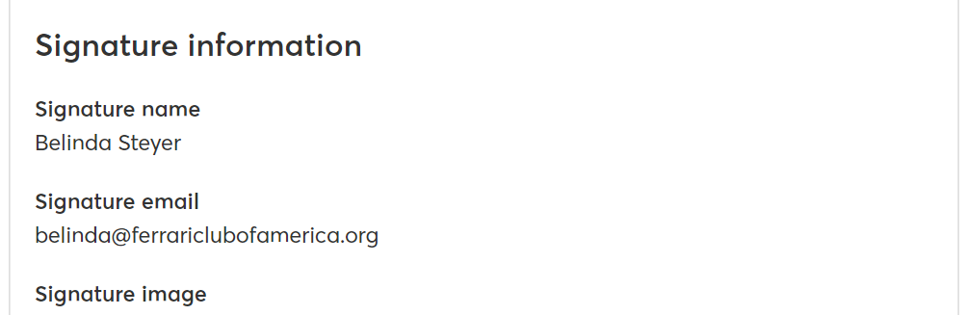
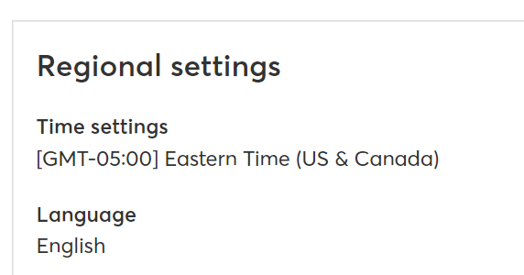
Presets
On this page you can also preset things like your Signature as well as your time zone and language.
Your specific Region or Chapter headers and National Partner footers have been supplied by National in a template.

Slide 16
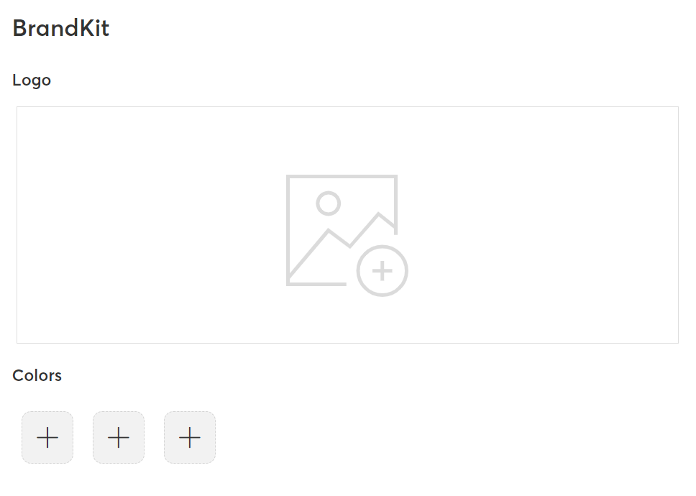
Brand Kit
We also recommend you update your BrandKit as this will make it easier to create cohesive branding across all of your emails.
Brand Colors
  Red- #cd212a
  Dark gray- #666666
  Yellow- #fff200

Slide 17
Contact Lists
Lists that are preloaded and maintained by National have a yellow star next to them.
These lists should not ever be deleted under any circumstances.
If you have an issue or question about lists and how to use them please contact Belinda.

Slide 18


Contact Lists
Get to your contact lists by clicking Contacts in the top menu.
Here you will find both manually created and preloaded lists.
Regional Accounts will see:
  A “Current Member General List” which includes the members of your region that are active (are not expired).
  A list for each chapter (if your region has chapters) starting with “CH-.” This will be a general list for each chapter.
Chapter Accounts will see:
  A “Current Member General List” which includes the members of your chapter that are active (not expired).

Slide 19

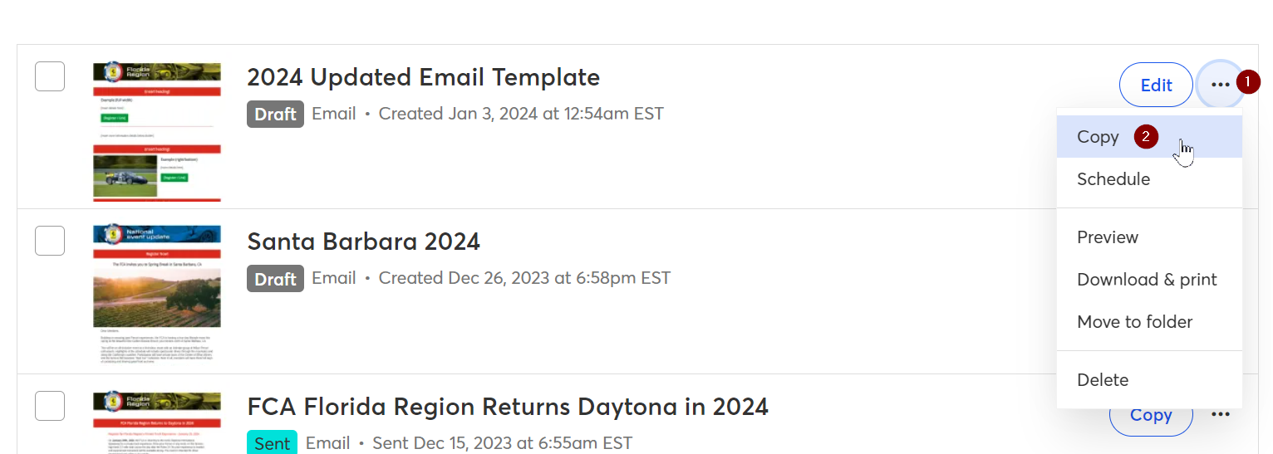
Making templates
There is a template available with current header and footer
  You can find this by clicking Marketing Campaigns in the top menu
  The template named 2024 Updated Email Template can be copied by clicking on the three dots and then click copy to create a template that you can modify

Slide 20

Making template updates
Here is a useful link for customizing content within the template
Here is also a step-by-step guide on crafting and sending an email
You can access the Ferrari Club logo here

